Slide 1

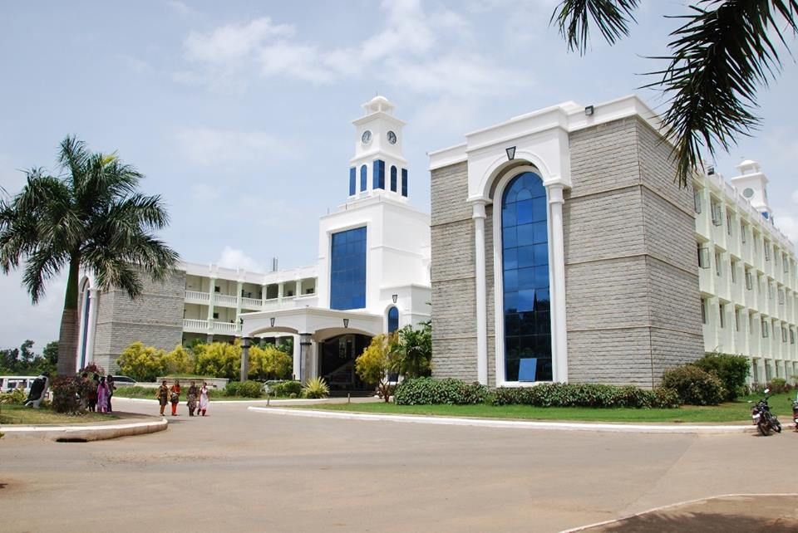



Srishyla Educational Trust (R), Bheemasamudra
G M INSTITUTE OF TECHNOLOGY
(Affiliated to VTU, Belagavi, Approved by AICTE -New Delhi & Govt. of Karnataka)
Department of Information Science & Engineering
Presentation On
Technical Seminar Presentation
“Cloud-Powered Mobility: A Seamless Integration Approach for Mobile Apps ”
YERRAMSETTY NIRMAL SAI TEJA (4GM21IS063)
.
Under the Guidance of
Mr. Imran Khan
B.E, M.Tech,(Ph.D)
Head of the Department:
Dr. Neelambike S
B.E, M.Tech, Ph.D,
Internship Coordinator
Mrs. Niveditha N M
B.E, M.Tech

Slide 2
G M INSTITUTE OF TECHNOLOGY
(Affiliated to VTU, Belagavi, Approved by AICTE -New Delhi & Govt. of Karnataka)
Department Of Information Science and Engineering
VISION
To evolve as an Excellent Technological Education Centre of Information Science and Engineering to create competitive professional engineers for the advancement of society.
MISSION
M1: To provide Application Specific Training & Practical Experience for developing Quality engineers in Information Science & Engineering. M2: To Inculcate Creative Skills in students to become Competent in the field of Information Science & Engineering. M3: To Inculcate Professional, Social and Ethical values in students to perform better in diverse environment.

Slide 3
G M INSTITUTE OF TECHNOLOGY
(Affiliated to VTU, Belagavi, Approved by AICTE -New Delhi & Govt. of Karnataka)
Program Educational Objectives
PEO1: To develop graduates who are proficient to solve wide range of computing related problems.
PEO2: To prepare graduates who have the necessary skills required for Higher Education & Entrepreneurship.
PEO3: To prepare graduates who have the ability to engage in Lifelong Learning.
Program Specific Outcomes
Graduates of Information Science & Engineering are:
1. Capable to design, develop & test the IT Solutions in real time.
2. Competent to apply knowledge to manage & monitor IT resources

Slide 4
G M INSTITUTE OF TECHNOLOGY
(Affiliated to VTU, Belagavi, Approved by AICTE -New Delhi & Govt. of Karnataka)
INTRODUCTION
BRIEF ON TECHNOLOGY
LITERATURE SURVEY
ADVANTAGES
ANALYSIS
CONCLUSION
REFERENCES
METHODOLOGY
TABLE OF CONTENTS

Slide 5

Introduction
Cloud-powered mobility refers to use cloud computing technologies to enhance the functionality, performance, and user experience of mobile applications.
This research is about how cloud technology can make mobile apps better, faster, and smarter. Instead of storing everything on your phone, the app stores and processes data in the cloud.
Mobile users benefit from improved access to data and applications anytime and anywhere, provided there is an internet connection.

Slide 6

Brief on Technology
Cloud Computing
Mobile Cloud Computing
Integration Platforms
App Development Approaches
Security & Privacy Technologies

Slide 7
LITERATURE SURVEY
TITLE | AUTHOR | ABSTRACT | YEAR
1. The Role of Cloud Computing Architecture in Big Data | M. Bahrami, M. Singhal | Discusses cloud architecture's influence on big data, covering scalability, storage, and analytics. | 2014
2. Big Data Computing and Clouds: Trends and Future Directions | M. Dias De Assunção et al. | Reviews current trends and future pathways in big data computing using cloud infrastructure. | 2015
3. Review of Mobile Cloud Computing | W. Song, S. Xiao-Long | A comprehensive review of mobile cloud computing and its architecture, challenges, and potential.. | 2011

Slide 8
TITLE | AUTHOR | ABSTRACT | YEAR
4. Mobile Cloud Computing as Future for Mobile Applications | S. S. Qureshi et al. | Discusses implementation methods and issues of mobile cloud computing in future applications. | 2011
5. Understanding Cloud Computing Vulnerabilities | B. Grobauer, T. Walloschek, E. Stöcker | Analyzes security vulnerabilities in cloud computing platforms. | 2011

Slide 9
ARCHITECTURE

Slide 10
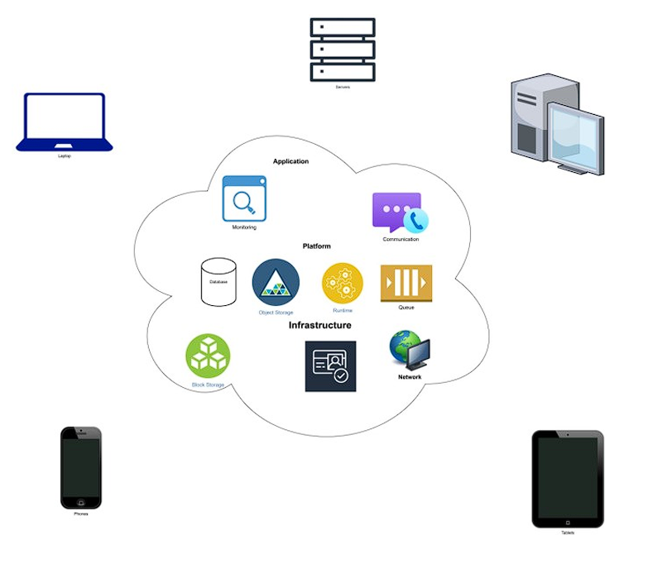
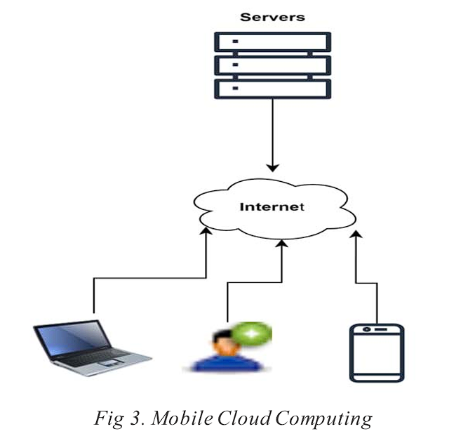
Cloud Computing
Mobile Cloud Computing

Slide 11
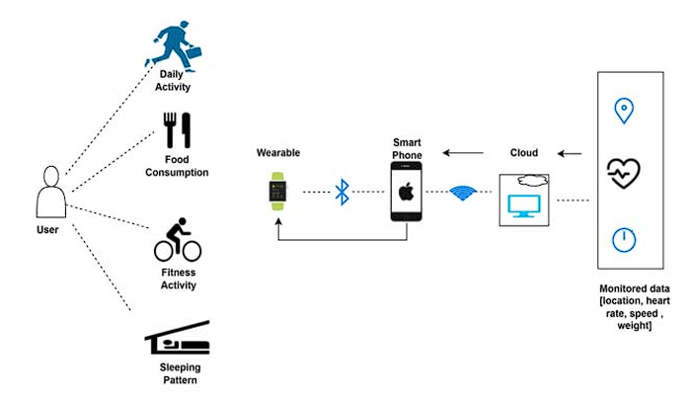
Examples for Mobile Cloud Computing

Slide 12
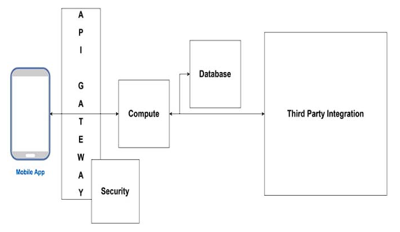
Traditional Approach For Integrating

Slide 13
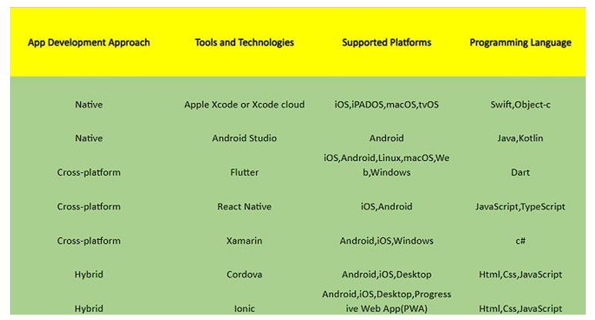
Tools and Technologies

Slide 14
Benefits
Greater ability to store the data.
Enhanced Functionality of the program.
Independence from Location.
Enhanced protection from malicious attacks

Slide 15
Analysis
The study demonstrates that integrating cloud computing into mobile application development enhances scalability, flexibility, and performance. By offloading data storage and processing to cloud platforms like AWS, Azure, and Google Cloud, mobile apps overcome hardware limitations such as limited memory and processing power.
Key findings include:
Improved User Experience
Enhanced Data Storage and Security
Development Efficiency
Real-world Applications
Challenges such as latency, network dependence, and data privacy remain critical.

Slide 16

Conclusion
Cloud-powered mobility has revolutionized the way mobile applications are developed and deployed.
It offers significant advantages such as cost-effective resource usage, enhanced security, increased storage capacity, and seamless access from any location.
These benefits not only improve user experience but also support the growing demand for mobile-first solutions in various industries.

Slide 17
References
M. Bahrami and M. Singhal, The Role of Cloud Computing Architecture in Big Data, Studies in Big Data, 2014.
M. Dias De Assunção et al., Big Data Computing and Clouds: Trends and Future Directions, Journal of Parallel and Distributed Computing, 2015.
W. Song and S. Xiao-Long, Review of Mobile Cloud Computing, 2011.
S. S. Qureshi et al., Mobile Cloud Computing as Future for Mobile Applications - Implementation Methods and Challenging Issues, 2011.
B. Grobauer, T. Walloschek, and E. Stöcker, Understanding Cloud Computing Vulnerabilities, IEEE Security & Privacy, 2011.
P. Hu, J. Shen, and S. Fang, Application of Mobile Cloud Computing in Operational Command Training Simulation System, 2012.
M. Nkosi and F. Mekuria, Cloud Computing for Enhanced Mobile Health Applications, 2010.

Slide 18
G M INSTITUTE OF TECHNOLOGY
(Affiliated to VTU, Belagavi, Approved by AICTE -New Delhi & Govt. of Karnataka)
THANK YOU

